Slide 1
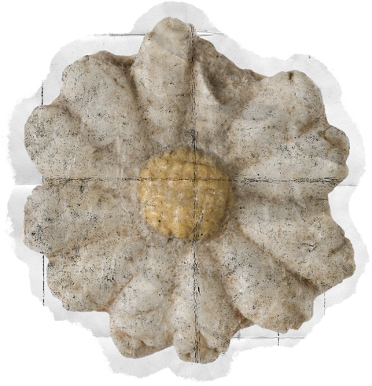

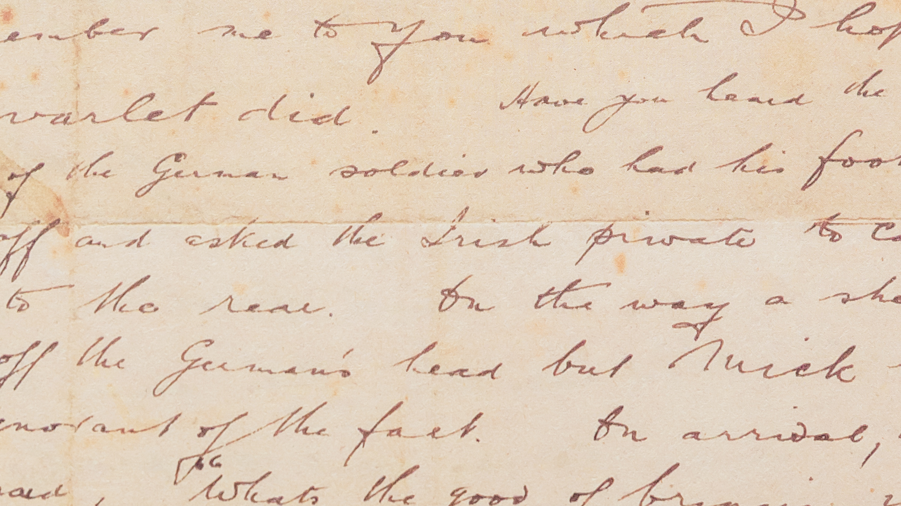
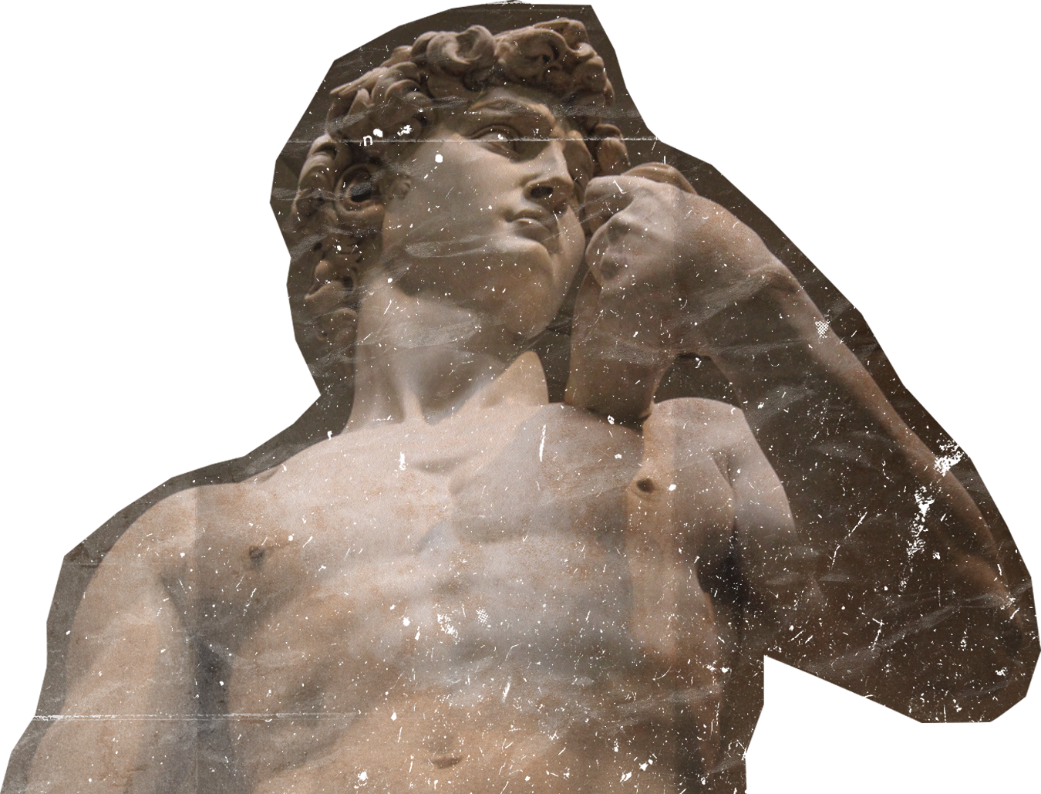
English Year 6
Unit 2 – Life in the past

Slide 2


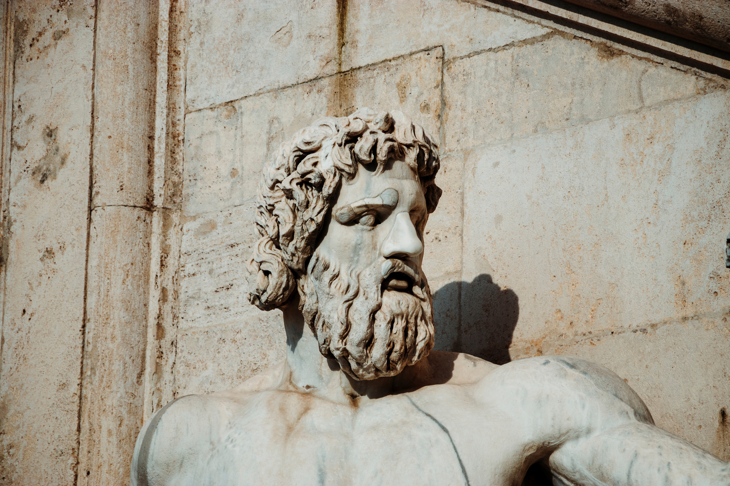
Learning Objectives
By the end of the lesson, pupils will be able:
Guess the meaning of unfamiliar words from clues provided by other known words and by context.
Understand specific information and details of simple longer texts.
Recognise and reproduce independently a wide range of target language phonemes.
Understand more complex supported questions.

Slide 3

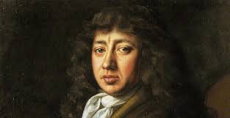

DO YOU RECALL WHO THIS IS?
Samuel Pepys (1633-1703) was an English naval administrator and Member of Parliament known for his extensive diary. Written from 1660 to 1669, the diary provides a detailed account of 17th-century England. It covers historical events like the restoration of the monarchy, the Great Plague of London, and the Great Fire of London. Pepys wrote candidly about his personal life, capturing everyday details and offering insights into social, cultural, and political aspects of the time.
His diary remained hidden until the 19th century when it was published, becoming a significant historical work. Pepys' diary is valued for its frankness, vivid descriptions, and portrayal of life in Restoration England. It continues to captivate readers, serving as a time capsule of a pivotal period in English history.

Slide 4
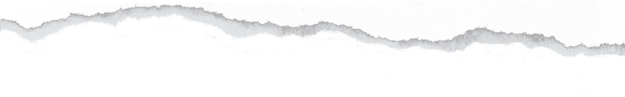

SHARING SESSION
LET'S PRACTISE USING "USED TO" AND "DIDN'T USE TO" TO TALK ABOUT THE STORY OF SAMUEL PEPYS.

Slide 5


Vocabulary Practice
So, how was the sharing session? Were you able to incorporate the vocabulary , "used to" and "didn't use to".
When do we use them?
"USED TO" AND "DIDN'T USE TO" ARE EXPRESSIONS USED TO TALK ABOUT PAST HABITS OR CONDITIONS THAT ARE DIFFERENT FROM THE PRESENT.
THESE EXPRESSIONS ARE USED TO DESCRIBE ACTIONS, BEHAVIOURS, OR SITUATIONS THAT WERE TRUE OR COMMON IN THE PAST BUT ARE NO LONGER TRUE OR COMMON NOW.

Slide 6

How do we use "used to"?
"used to" is used to talk about past habits, actions, or situations that occurred regularly or for a long period in the past but are no longer happening now.
Structure: Subject + used to + base verb
.
I used to live in the countryside.
This means I lived in the countryside in the past, but now I don't live there anymore.
She used to play the piano every day.
This means she played the piano regularly in the past, but she doesn't do it anymore.
We used to go camping every summer.
This means we went camping every summer in the past, but we don't do it anymore.

Slide 7
How do we use "didn't use to"?
"didn't use to" is used to talk about past habits, actions, or situations that were not true or common in the past but have changed and become true or common now.
Structure: Subject + didn't use to + base verb
.
I didn't use to like broccoli, but now I love it.
This means I didn't like broccoli in the past, but now I enjoy eating it.
They didn't use to have a pet, but now they have a dog.
This means they didn't have a pet in the past, but now they own a dog.
He didn't use to speak Spanish, but now he is fluent.
This means he didn't speak Spanish in the past, but now he can speak it fluently.

Slide 8
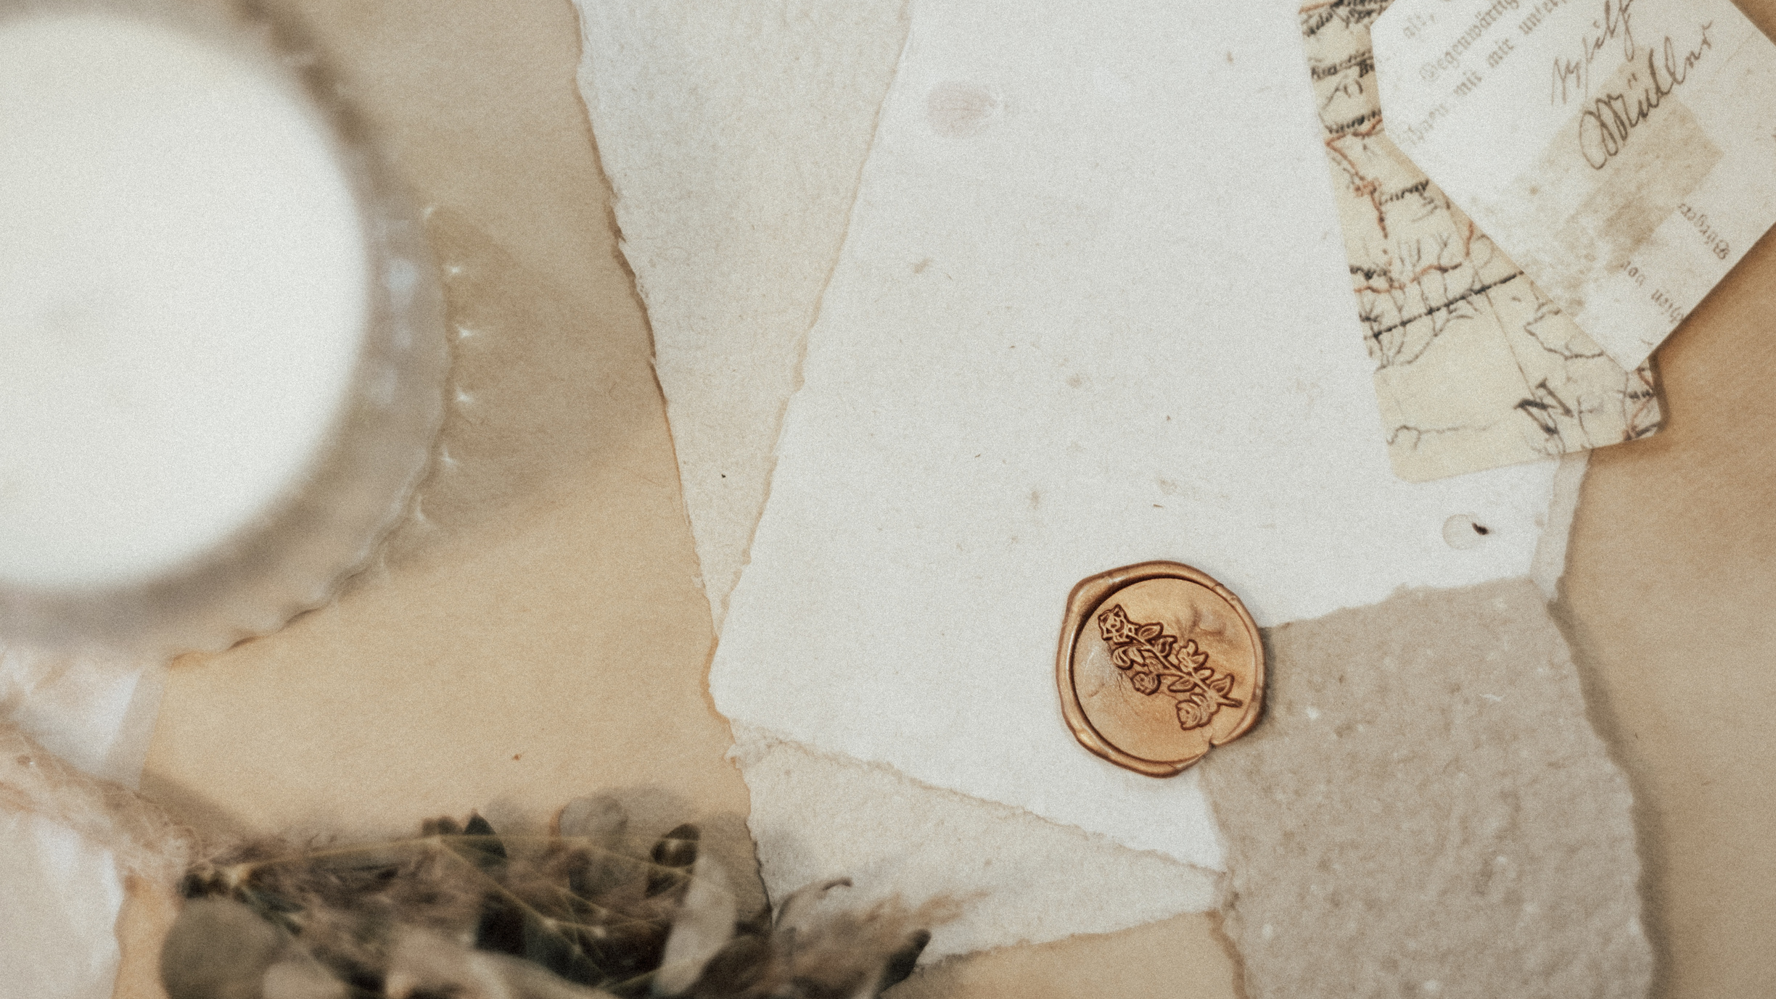
THANK YOU

